Slide 1

NEW DELHI

Slide 2
MISSION STATEMENT
At SBS CASA we thrive to make your stay as comfortable and wholesome as possible.
We provide optimum lodgings, delicious meals, regular maintenance and multiple amenities.
Expansion of business by venturing into newer avenues and diversifying the portfolio.
Creating a self dependent incremental revenue source.

Slide 3








ROOM AMENITIES
BOX BED
STUDY TABLE
MATTRESS
CHAIR
PILLOW
LAMPS
BED SHEETS
INDIVIDUAL
ALMIRAH

Slide 4









ROOM AMENITIES
AC
BUCKET AND MUG
FRIDGE
DUSTBIN
ATTACHED
WASH
MIRROR
GEYSER
CLOTHES HANGER

Slide 5









COMMON FACILITIES
GYM
WEEKLY BED SHEET CHANGE
LAUNDRY SERVICE
CARD READER LOCK
WIFI
RO Drinking Water
CCTV CCAMERAS

Slide 6






FOOD
3 TIMES VEG. MEALS
MENU CHANGE EVERY WEEK
FOOD PREPARED ON SPECIAL REQUEST
BEST QUALITY PRODUCTS USED

Slide 7






AMENITIES IN CLOSE PROXIMITY
100 METRES FROM MAIN ROAD
PARK
ATM
100 METRES FROM HOSPITAL
MARKET

Slide 8
INVESTMENT ANALYTICS
We need 1.25 Crore investment, and we are ready to offer one option from the following:
1) Return on investment1.5% Per Month
Annual Return on Investment 18%
After 3 years Sbs Casa will return the investment.
2) Profit sharing ratio on equity- 20% for 1.25 crores

Slide 9
WHERE INVESTMENT WILL BE USED
320 New Beds will be added to the existing 180 beds making it a total of 500 Beds.
1 Gym will be setup with a cost of 20 lakhs.
1 Laundry setup with cost of 9 Lakhs.
1 Restaurant and base kitchen will be setup with a cost of 12 Lakhs.

Slide 10
OCCUPANCY ANALYSIS
Occupancy | 80% | 85% | 90% | 95%
Seats | 400 | 425 | 450 | 475
Revenue | 40 lakhs | 42.5 lakhs | 45 lakhs | 47.5 lakhs
Rent | 17.5 lakhs | 17.5 lakhs | 17.5 lakhs | 17.5 lakhs
Average cost per student | 4556 | 4556 | 4556 | 4556
Total cost | 18,22,400 | 19,36,300 | 20,50,200 | 21,64,100
Rental profit | 4,27,600 | 5,63,700 | 6,99,800 | 8,35,900

Slide 11
SELF SUSTAINING ECOSYSTEM
SBS Casa provides for a self-sustaining revenue generating ecosystem.
It would comprise of 500 beds, 1 gym, 1 laundry, 1 restaurant along with its own dedicated mobile application and a website.
The occupancy of one bed comes with the unconditional membership of the gym, the restaurant and paying for the laundry service even if the occupant does not avail the services.
The disparity in services being paid for even when not used, deducted from the revenue thus generated will bring about more profit margins than otherwise anticipated creating a self-sustaining revenue generation loop.
Eventually non occupants can also pay for the ancillary services thus further boosting the revenue stream.
On reaching a 500-bed occupancy even though the increment in rent from newer beds will come to a relative standstill, a self-sustaining ecosystem will provide for a multitude of income opportunities- the gym, laundry and the restaurant will attract clients.
Thus, the profits generated within 5 years would be used to initiate new ventures and expand the reach of the existing infrastructure.

Slide 12
SELF SUSTAINING ECOSYSTEM
We Will Charge 10000Rs Per Person and we will pay accordingly.
Per Person | 10000
Rent Paid | 3500
Food | 3000
Gym | 500
Laundry | 400
Electricity & Water | 275
Staff & Cleaning | 250
Wi-Fi | 66
Maintenance | 66
Profit | 1943

Slide 13
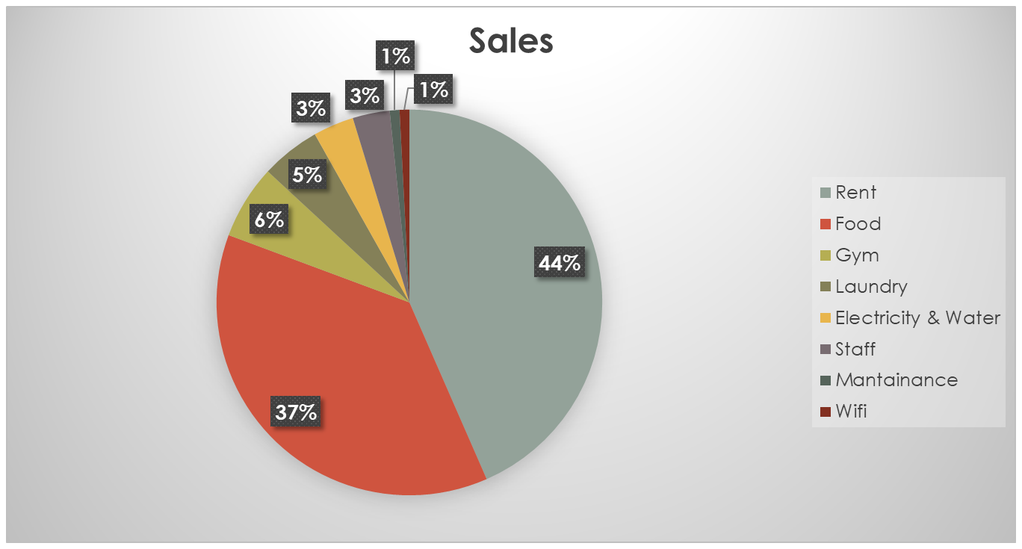
SELF SUSTAINING ECOSYSTEM

Slide 14
HISTORY OF SBS CASA
SBS Casa was opened about 3 years ago in April 2018 with an occupancy of 27 beds.
In February 2020 71 beds in 24 1bhk units were added to our existing Inventory.
In February 2021 42 beds were added in 12 bhk with 3 rooms with attached washroom and kitchen.
In April 2021an increment of 7 rooms 14 beds.
In September 6 2bhk units was followed by an addition of 28 beds bringing the total to 182 beds.
Our Occupancy have been 95% since the opening of first Lockdown.
We have shown a growth of
We have a return of 1.5% till now on our Investment which will grow once the Offline Classes start.

Slide 15
5-YEAR PLAN
Once we reach our Goal of 500 Beds by April 2022, we will explore new markets such as Jia Sarai and Katwariya Sarai.
We will implement the same system by adding 300 new beds a new Gym, Restaurant although for the second year we will use our base kitchen and won't add a new Laundry.
We will continue adding beds and gym restaurant and laundry to all the new markets we explore hence making it a Self sustaining eco System.
When we have reached a total of 2000+ beds 4 gym 4 restaurants 4 Laundry. We will then look for a bigger investment to enter New States and explore bigger Markets.

